Slide 1

Natural Language Processing NLP in one day

Slide 2

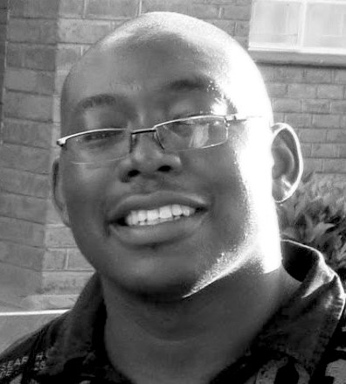
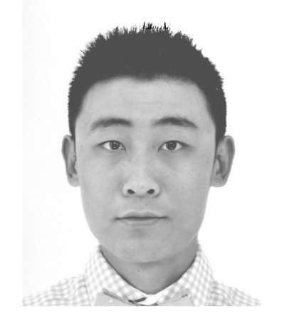
Introduction
Angus Roberts
Senior Lecturer,
Health Informatics
Yamiko Msosa
Research Fellow,
Health Informatics
Leo Xinyue Zhang
PhD Student,
Clinical NLP

Slide 3
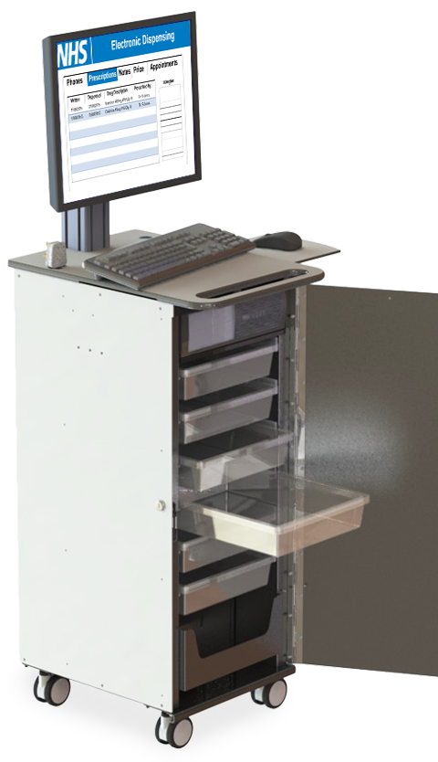

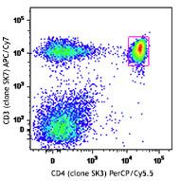
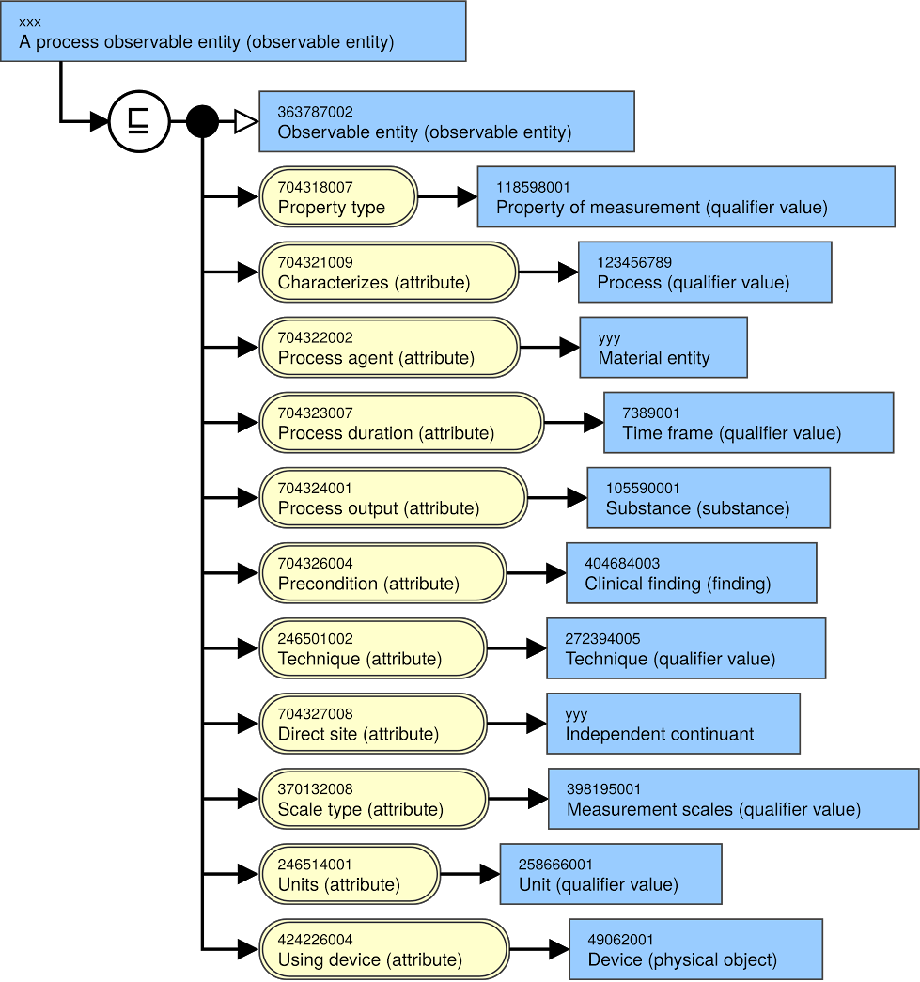

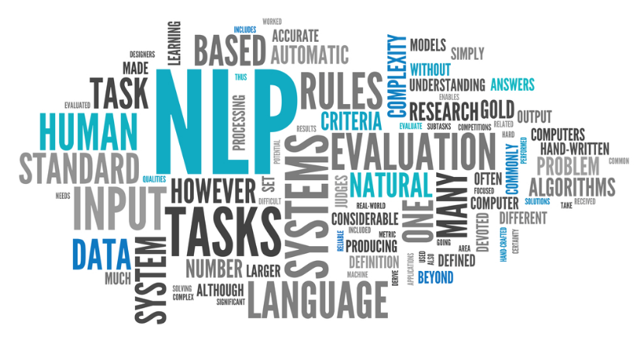
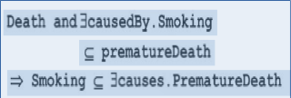
My journey

Slide 4
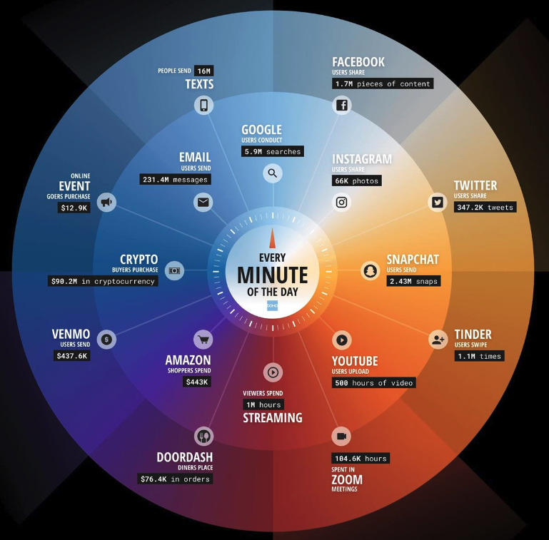
Text is everywhere
Data Never Sleeps 10.0 from domo.com (April 2022)

Slide 5
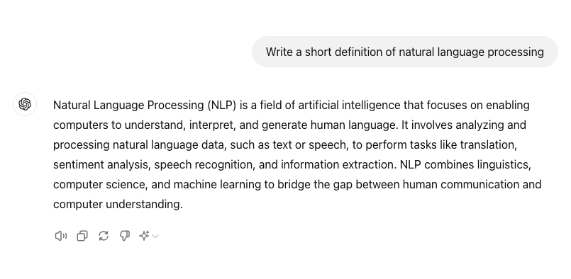

Generative AI

Slide 6
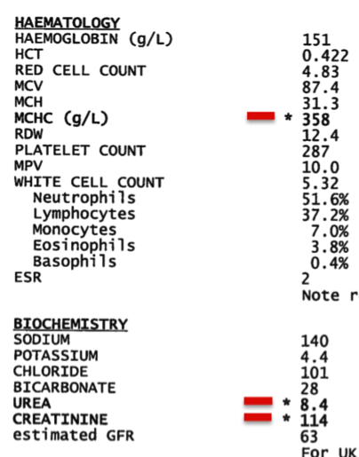
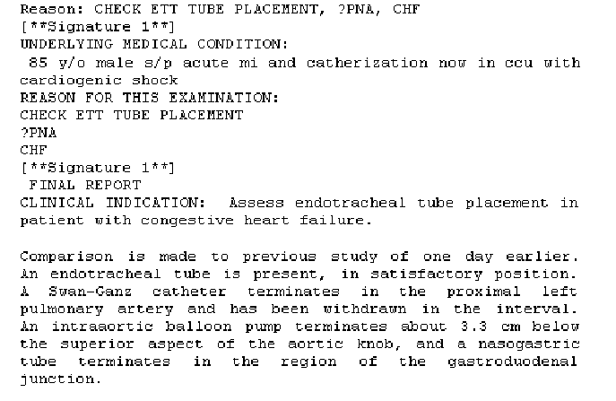
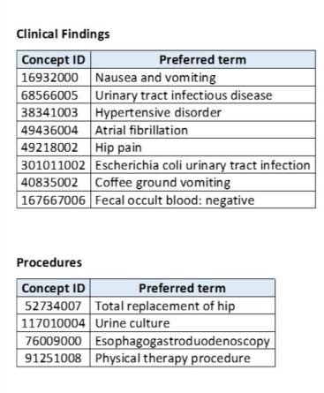
Electronic health records (EHRs) – structured and unstructured information

Slide 7
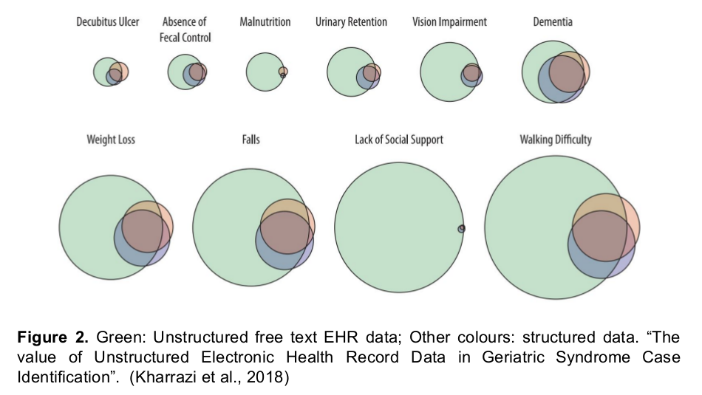
How much unstructured, textual information is in an EHR?

Slide 8
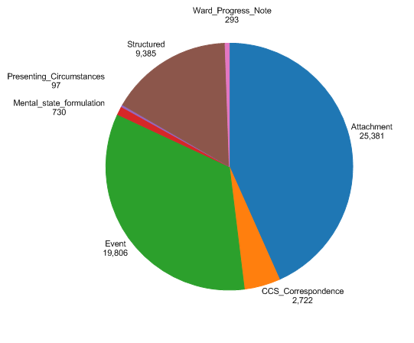
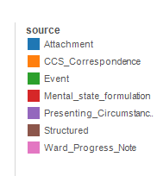
An example – Mini Mental State Examinations

Slide 9
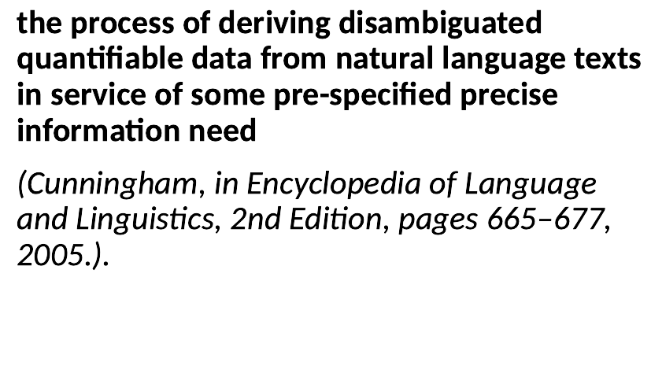
Information extraction

Slide 10
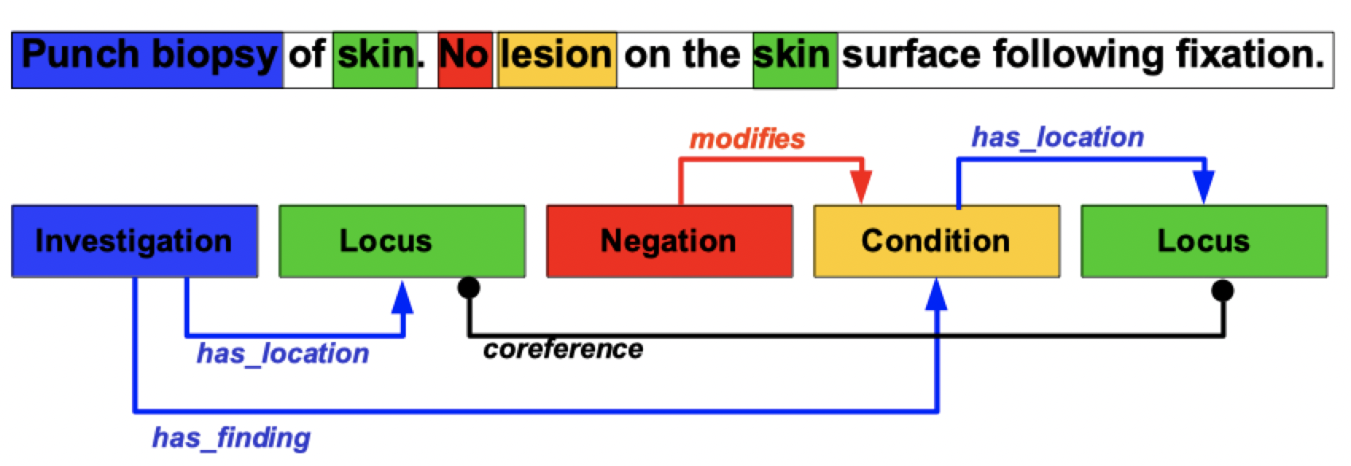
Information extraction
We might extract:
Entities and their co-referents
Negation, certainty
Relations
Events
Temporal expressions and relations

Slide 11
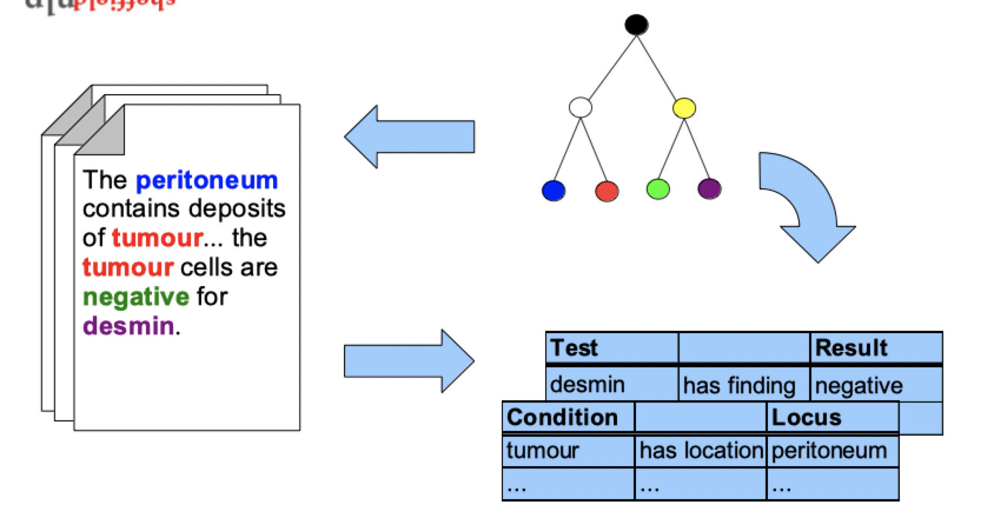
Entity linking

Slide 12
This course
Pre-workshop - video lectures and study material
You did do all of it, didn’t you?

Slide 13
This course
Pre-workshop - video lectures and study material
You did do all of it, didn’t you?
Workshop – practicals
And a few linking presentations

Slide 14
This course
Pre-workshop - video lectures and study material
You did do all of it, didn’t you?
Workshop – practicals
And a few linking presentations
Post-workshop – self-study reading material

Slide 15
This course
Pre-workshop - video lectures and study material
You did do all of it, didn’t you?
Theory, methods
Workshop – practicals
And a few linking presentations
Post-workshop – self-study reading material

Slide 16
This course
Practical
techniques
Pre-workshop - video lectures and study material
You did do all of it, didn’t you?
Theory, methods
Workshop – practicals
And a few linking presentations
Post-workshop – self-study reading material

Slide 17
Can you learn NLP in a day
No
Watch the pre-course material
Go through the reading material
Find other sources of information
Find a collaborator!

Slide 18
Course material
All course material can be found on GitHub
Let’s take a look:
https://github.com/KCL-Health-NLP/nlp-one-day-workshop/tree/main

Slide 19
Thank you
angus.roberts@kcl.ac.uk https://www.kcl.ac.uk/people/angus-roberts

